Slide 1

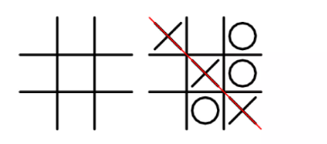
PROJECT:TIC TAC TOE
BY: Abhishek Kumar
CSE(5TH SEM)
LOVELY PROFESSIONAL UNIVERSITY
12012026

Slide 2
Aims And Objectives
Introduction to the topic
Current Scenerio
System Functionality
Algorithm
Reference

Slide 3
Introduction
Tic Tac Toe is a very simple and popular game
Two Players Are Required
3X3 grid
A paper and pen based game

Slide 4
Why Tic Tac Toe ?
Rules for Tic Tac Toe game is simple enough thet we don’t need an elaborate analysis of game configurations.
Despite being simple game ,the basic Algorithm shown here can be used in many more complicated games such as checkers or chess.

Slide 5
Present Scenerio
Many version of Tic Tac Toe like 3X3,4X4 and even 9X9.
Can be made on various platforms like Python, Java, C++ etc.
Not so Complex Architecture.

Slide 6
Functionality
How To Play Tic Tac Toe!
The game is played between two players.
Each players choose their respective symbols to mark
Both players marks a block by their symbol
Both players make their turn alternately
If any player get three respective symbols in a horizontal, vertical or diagonal row wins the game.

Slide 7
Algorithm Used:
Mini-Max Algorithm-
Mini-max algorithm is used in decision-making and game theory. It provides an optimal move for the player assuming that opponent is also playing optimally.
Mini-Max algorithm uses recursion to search through the game-tree.

Slide 8
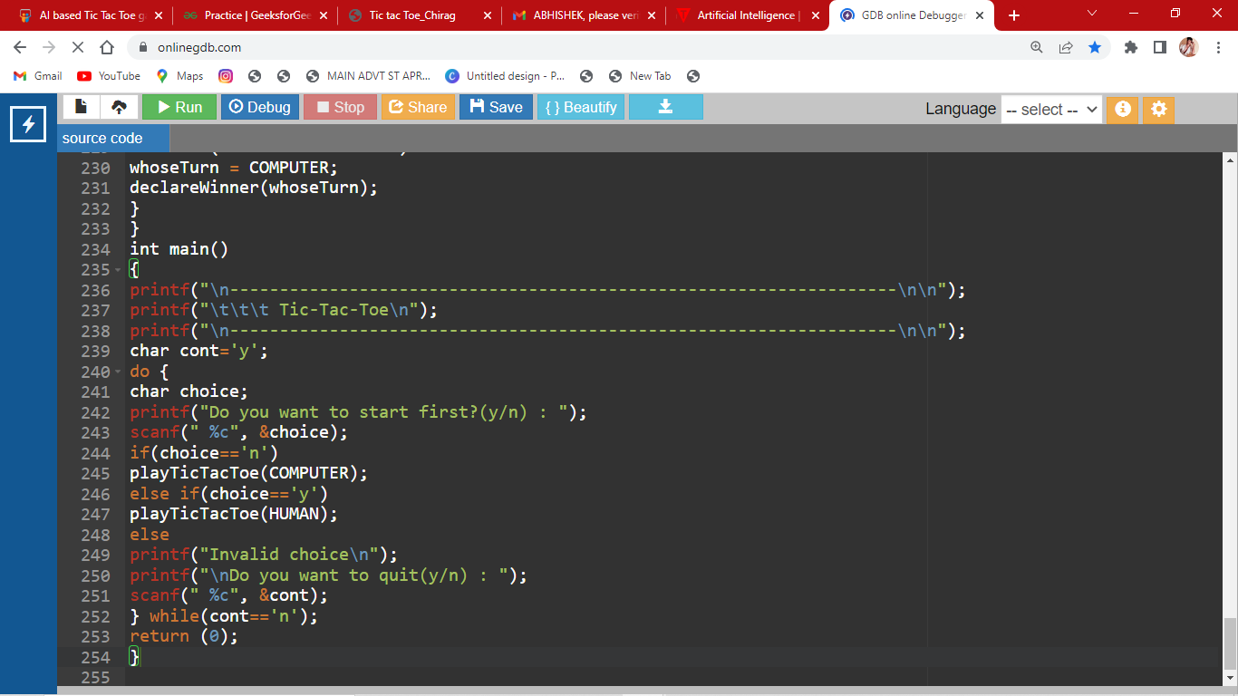
Code Screenshots:

Slide 9
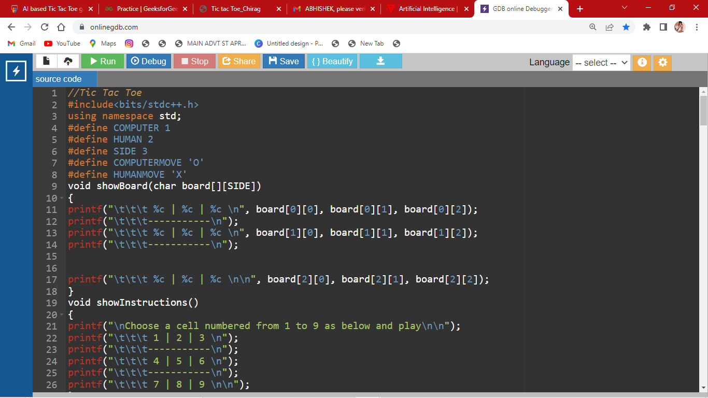

Slide 10
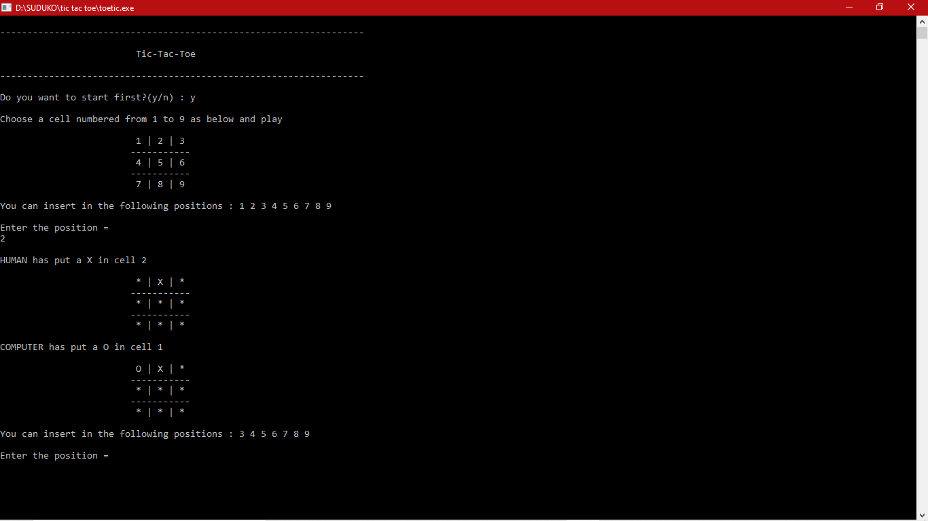
Output:

Slide 11
Reference:
Geeks For Geeks

Slide 12
THANK YOU

